Slide 1
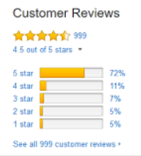
Capstone Project - 4
Team 2 : Product Recommendation Engine
Present By
Dilavar Singh

Slide 2
Content
Problem Statement
Data Summary
Recommendation System
Product Recommendation
Approaches of Recommendation Systems
Exploratory Data Analysis
Machine Learning Algorithm
Challenges
Conclusion

Slide 3
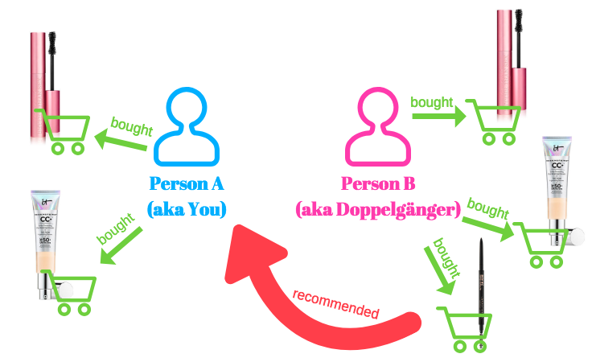
Problem Statement
Many online businesses rely on customer reviews and ratings. Explicit feedback is especially important in the ecommerce industry where all customer engagements are impacted by these ratings. Amazon relies on such rating data to power its recommendation engine to provide the best beauty product recommendations that are personalized and most relevant to the user.
Build a recommender engine that reviews the customer ratings and purchase history to recommend items and improve sales for beauty products.

Slide 4

Data Summary
Total Row - 198502
Total columns - 9
reviewerID - UserId
asin - ProductId
reviewer Name - User Name
helpful
review Text
overall - Rating
summary
unixReviewTime
review Time

Slide 5
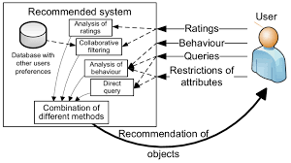
Recommended Systems
Sharp system that provides idea about item to users that might interest them.
Recommendation system is subclass of information filtering to predict preferences to the items used by or for users. It personalize recommendation and deals with information overload. These demands throws some challenges so different approaches like memory based, model based are used.

Slide 6

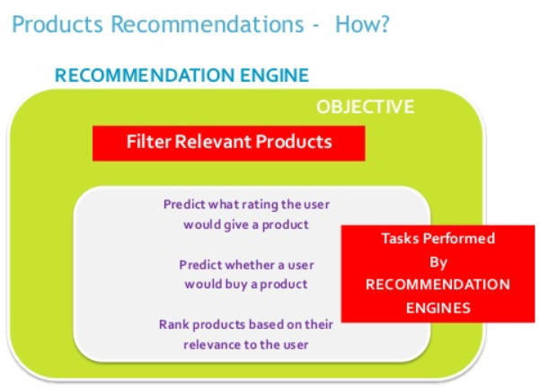
Product Recommendation

Slide 7
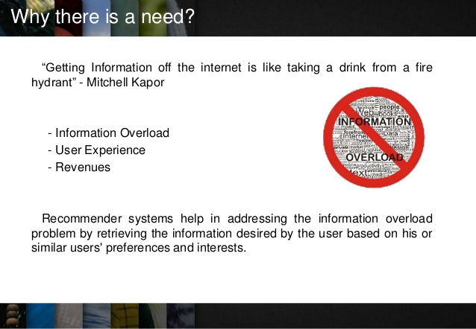
Need of recommendation systems:

Slide 8
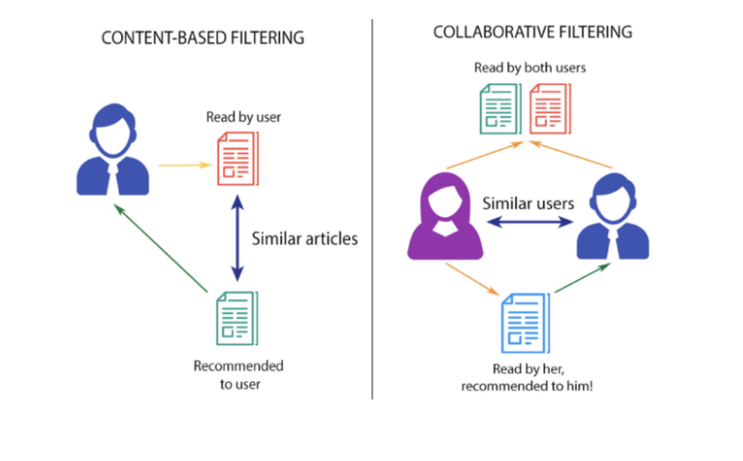
Approaches of Recommendation System
Recommendation system is usually classified on rating estimation:
Collaborative Filtering system
Content based system
Hybrid based system
ative Filtering system Content based sy

Slide 9
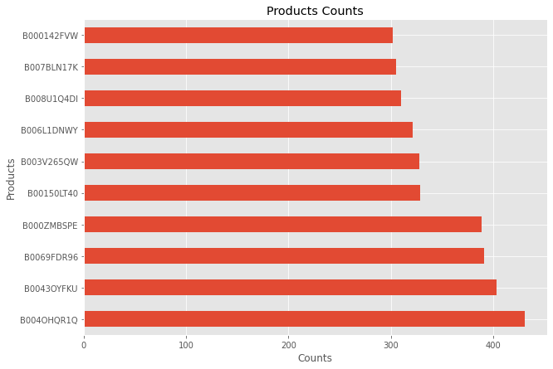
Exploratory Data Analysis
Feature Name - ProductId
Plotted graph has only top 10 products.
The graph is showing how many times a particular product has been sold.

Slide 10
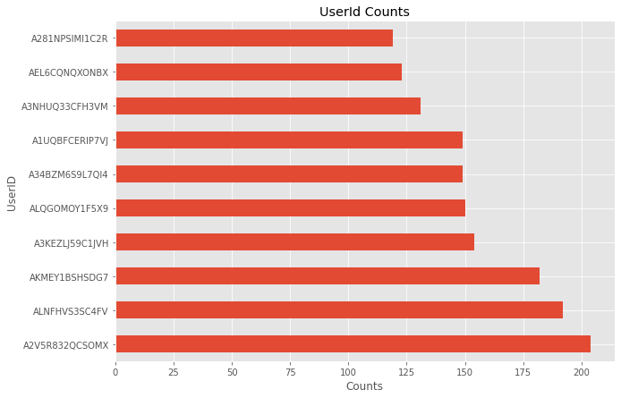
EDA Contd.
Feature Name - UserId
Plotted graph has only top 10 Users.
The graph is showing how many times a particular user has purchased a products.

Slide 11
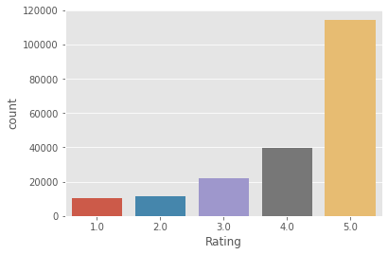
EDA Contd.
From chart it’s clear that -
Most of the product has given as highest rating.
Very less number of product has low rating.

Slide 12
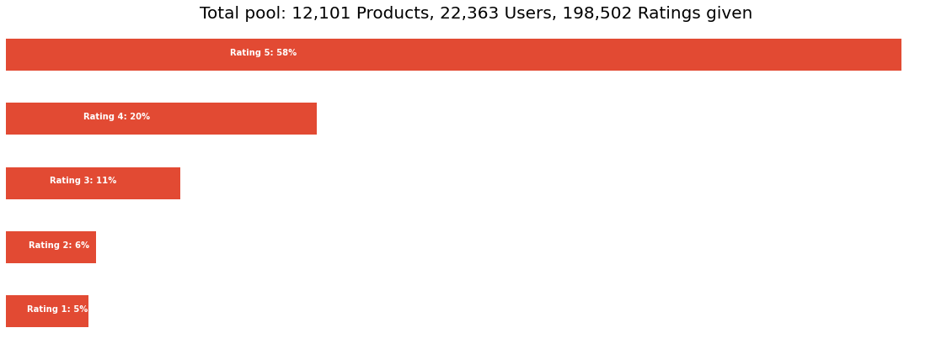
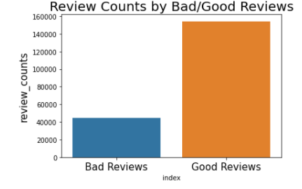
EDA Contd.

Slide 13
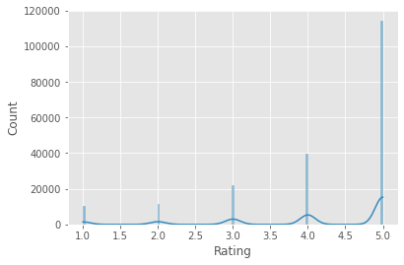
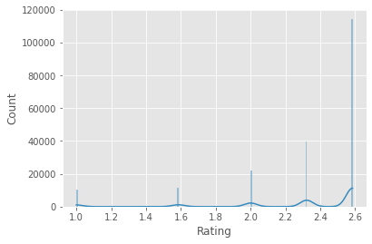
EDA Contd.
Before Log Transformation
After Log Transformation

Slide 14
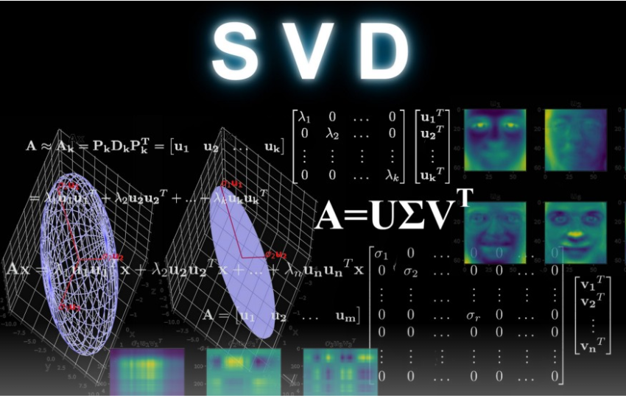
SVD - Singular Value Decomposition
The Singular-Value Decomposition, is a matrix decomposition method for reducing a matrix to its constituent parts in order to make certain subsequent matrix calculations simpler. It provides another way to factorize a matrix, into singular vectors and singular values.

Slide 15
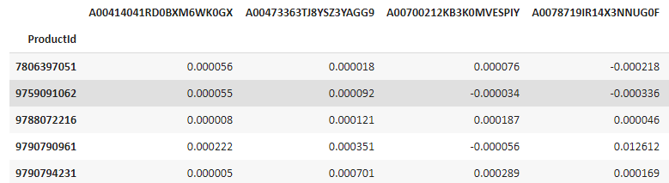
Collaborative Recommendation System
Machine Learning Algorithm
No of Components in SVD = 35
Pivot Matrix: Shape (22363,12101)

Slide 16
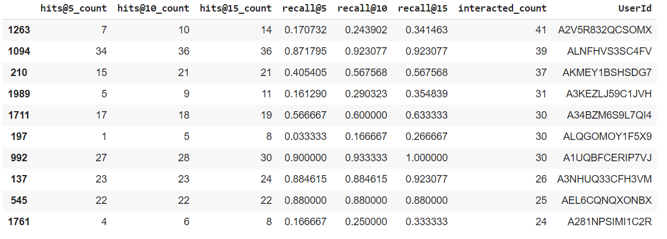
Evaluation for Collaborative Filtering
Overall Accuracy
recall@5: 0.3847
recall@10: 0.4759
recall@15: 0.5358
Random 10 User Id Details

Slide 17
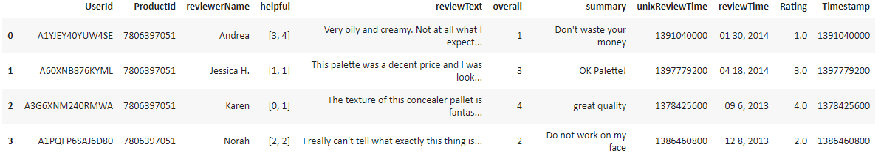
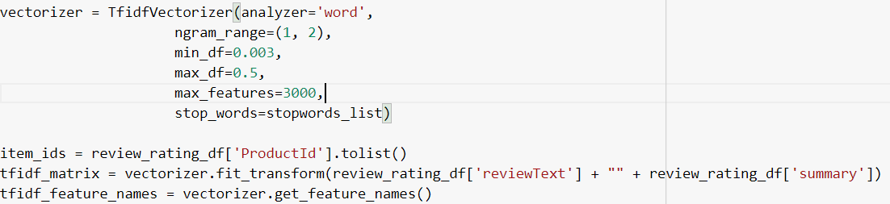
Content-Based Recommendation System
Dataset
TF-IDF Vectorizer Technique

Slide 18
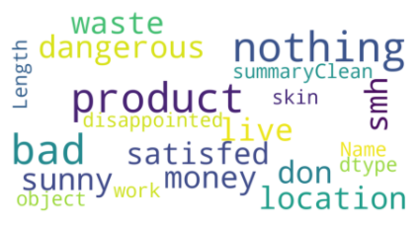
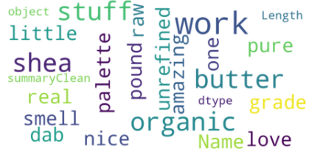
Contt..
Low Score Words
High Score Words

Slide 19
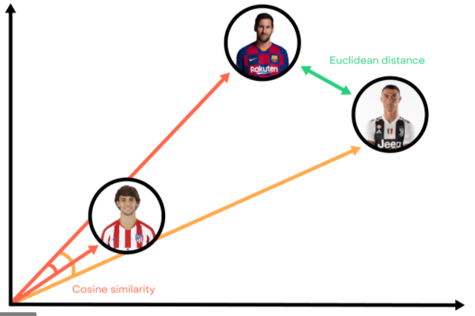
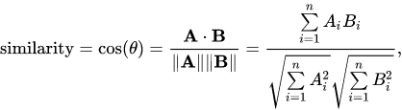
Cosine Similarity
Cosine similarity measures the similarity between two vectors of an inner product space.
It is measured by the cosine of the angle between two vectors and determines whether two vectors are pointing in roughly the same direction.
It is often used to measure document similarity in text analysis.

Slide 20
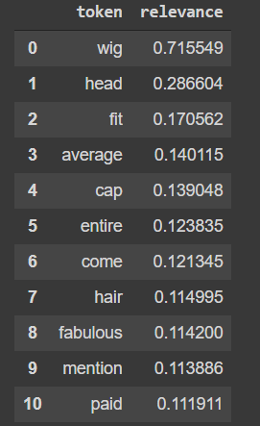
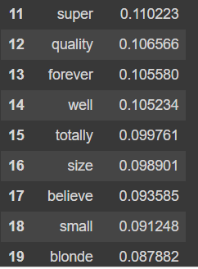
Token Relevance to a Particular User
UserId: A00414041RD0BXM6WK0GX

Slide 21
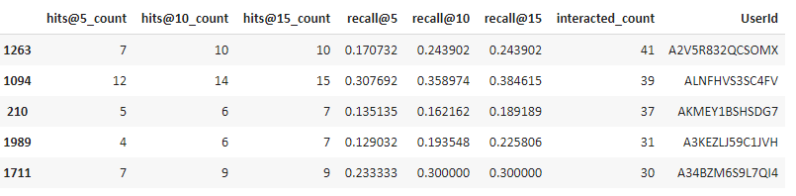
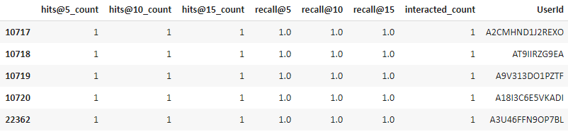
Evaluation for Content - Based Recomm...
recall@5:0.83814
recall@10:0.8630
recall@15:0.8680

Slide 22
Challenges
High Volume of Data.
Elevating evaluation score for the models.
Crashing of session due to large pivot matrix.
Choosing optimal number of Factors in SVD.
Implementing of Hybrid recommendation Model.

Slide 23
Conclusion
We got recall@5: 0.3847 and recall@10: 0.4759 for collaborative Model.
We got recall@5: 0.83814 and recall@10: 0.8630 for content-based Model.
As we can see We are getting better recall value for content-based model than collaborative model.
So we can conclude that content-based model is optimal model for product recommendation.

Slide 24
Thank You

Slide 25
Q & A

